Slide 1
CIS CONTROL 20: PEN TESTS & RED TEAM EXERCISES-II
PENETRATION TESTS & RED TEAM EXERCISES

Slide 2
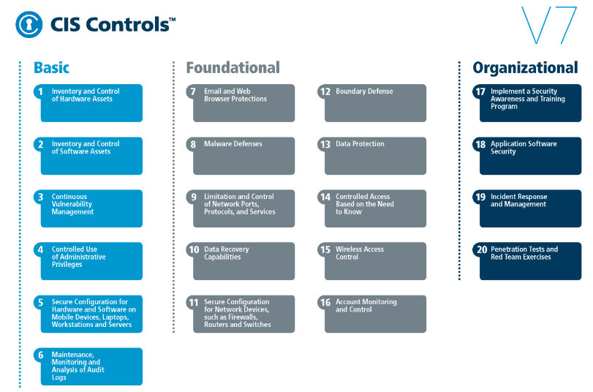
CIS CONTROL 20: PEN TESTS & RED TEAM EXERCISES-II
https://www.cisecurity.org/controls/

Slide 3
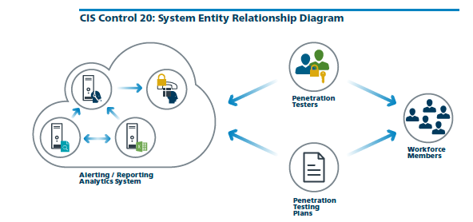
CIS CONTROL 20: PEN TESTS & RED TEAM EXERCISES-II
https://www.cisecurity.org/controls/

Slide 4
CIS CONTROL 20: PEN TESTS & RED TEAM EXERCISES-II
20.5: Create Test Bed for Elements Not Typically Tested in Production
Create a test bed that mimics a production environment for specific penetration tests and Red Team attacks against elements that are not typically tested in production, such as attacks against…

Slide 5
CIS CONTROL 20: PEN TESTS & RED TEAM EXERCISES-II
20.5: Create Test Bed for Elements Not Typically Tested in Production
…supervisory control and data acquisition and other control systems.

Slide 6
CIS CONTROL 20: PEN TESTS & RED TEAM EXERCISES-II
20.6: Use Vulnerability Scanning and Penetration Testing Tools in Concert
Use vulnerability scanning & penetration testing tools in concert. The results of vulnerability scanning assessments should be used as a starting point to guide & focus pen testing efforts.

Slide 7
CIS CONTROL 20: PEN TESTS & RED TEAM EXERCISES-II
20.7: Ensure Results from Penetration Test are Documented Using Open, Machine-readable Standards
Wherever possible, ensure that Red Teams results are documented using open, machine-readable standards (e.g., SCAP). Devise a scoring …

Slide 8
CIS CONTROL 20: PEN TESTS & RED TEAM EXERCISES-II
20.7: Ensure Results from Penetration Test are Documented Using Open, Machine-readable Standards
…method for determining the results of Red Team exercises so that results can be compared over time.

Slide 9
CIS CONTROL 20: PEN TESTS & RED TEAM EXERCISES-II
20.8: Control and Monitor Accounts Associated with Penetration Testing
Any user or system accounts used to perform penetration testing should be controlled and monitored to make sure they are only being used for legitimate purposes, …

Slide 10
CIS CONTROL 20: PEN TESTS & RED TEAM EXERCISES-II
20.8: Control and Monitor Accounts Associated with Penetration Testing
…and are removed or restored to normal function after testing is over.
END

